Slide 1
Melbourne Housing Data
Presented by:
Akanksha Nichrelay
Arjun Malhotra

Slide 2
Objective
To predict the prices of Houses, using regression models.ze ML regression models to solve a real-world problem
Utilize ML regression models to solve a real-world problem

Slide 3
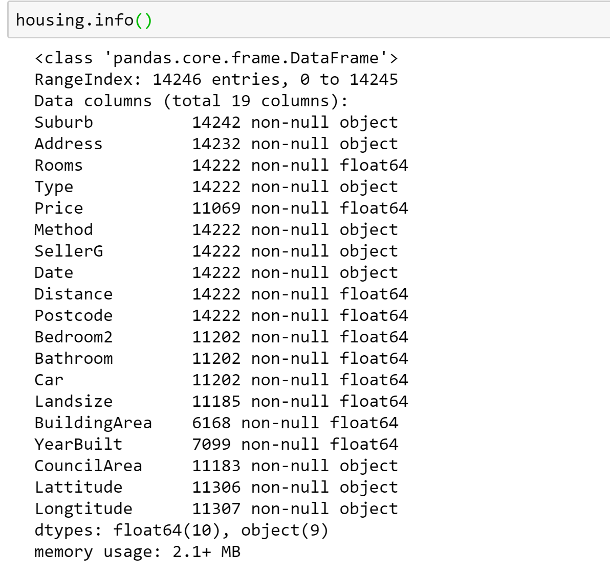
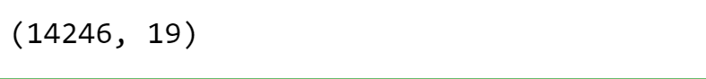
About Dataset
Notes:
1st shape then info then describe

Slide 4
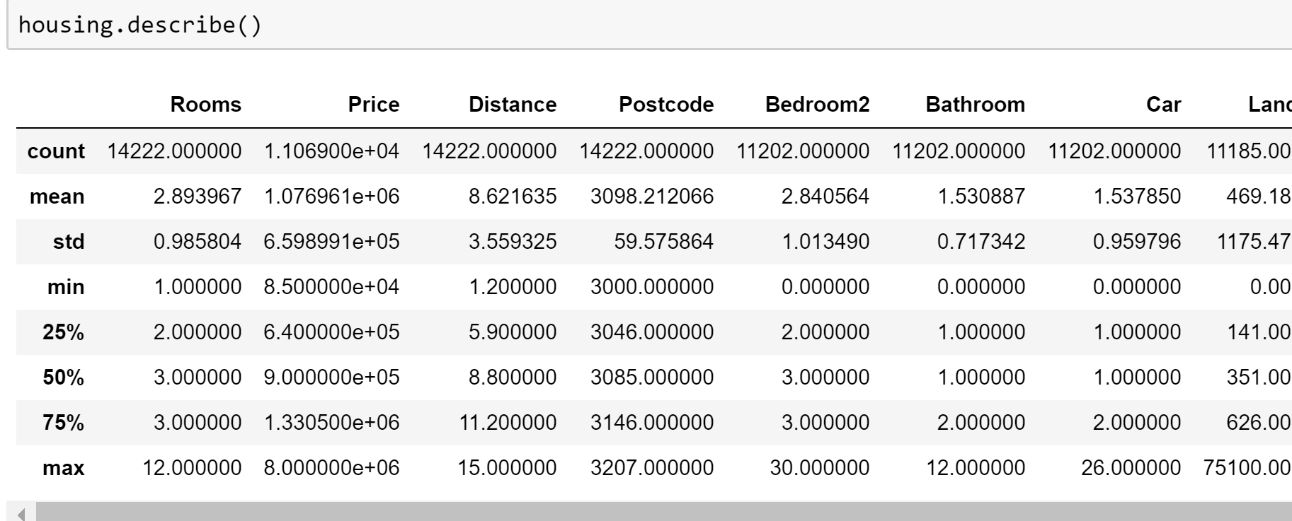

Slide 5
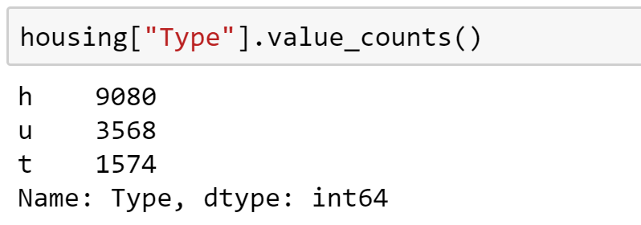
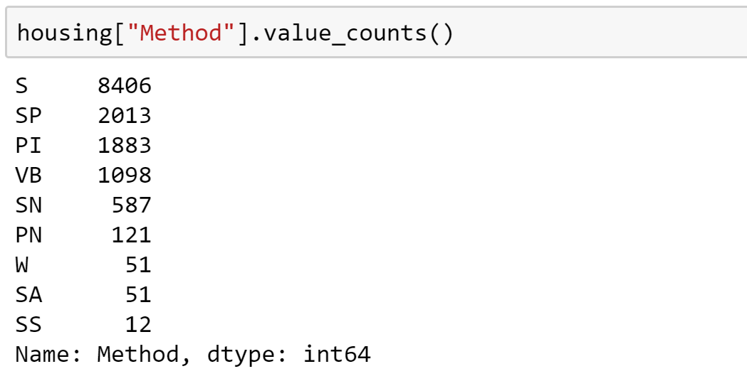
Features study
Notes:
We found two meaningful categories that we can encode.

Slide 6
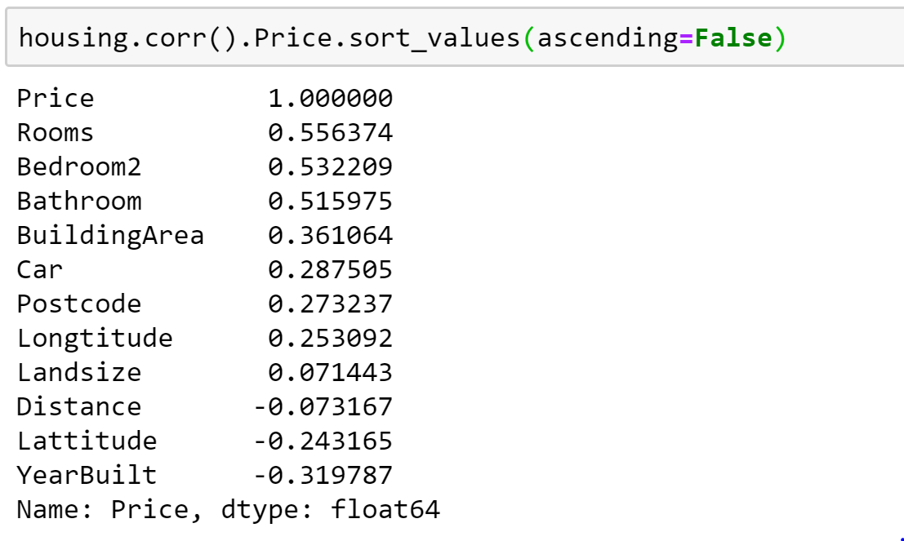
Correlation
Notes:
Only moderate correlation. So we look at the features more closely

Slide 7
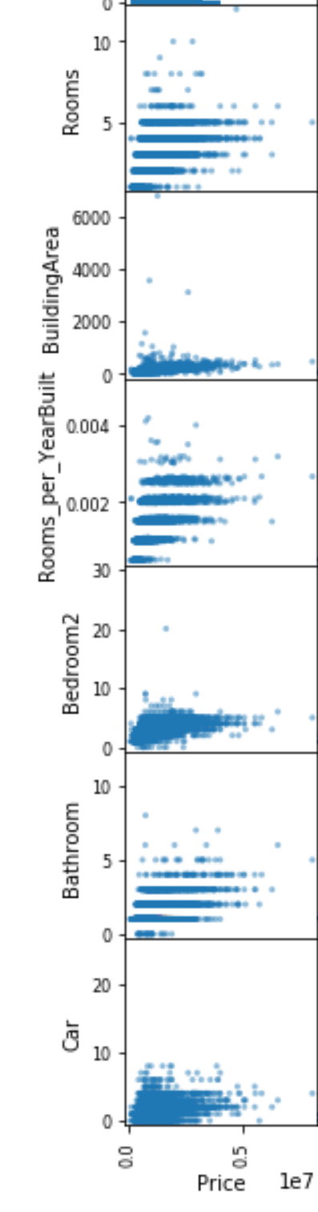
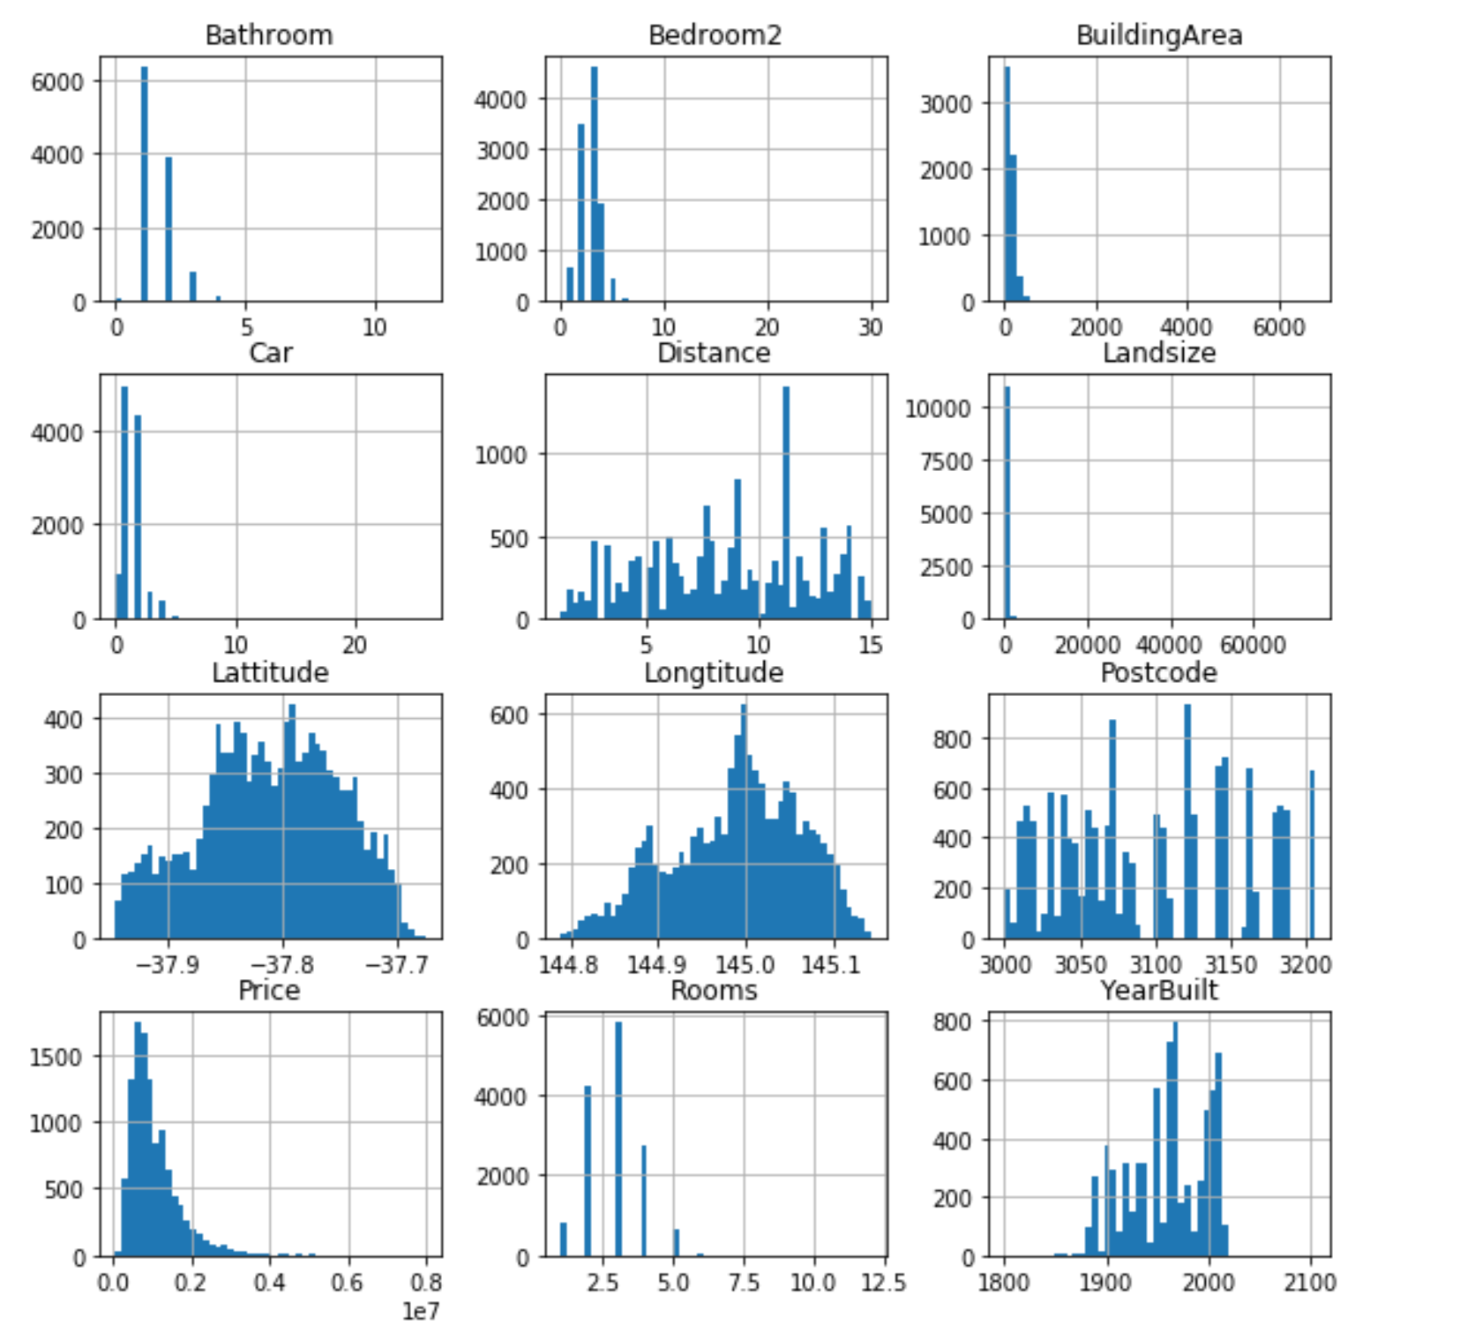
Histogram and Scatter plots
Notes:
Change order

Slide 8
Feature Combination
Notes:
Tried different combination of features and selected the best ones
Dropped the ones with near 0 correlation.

Slide 9
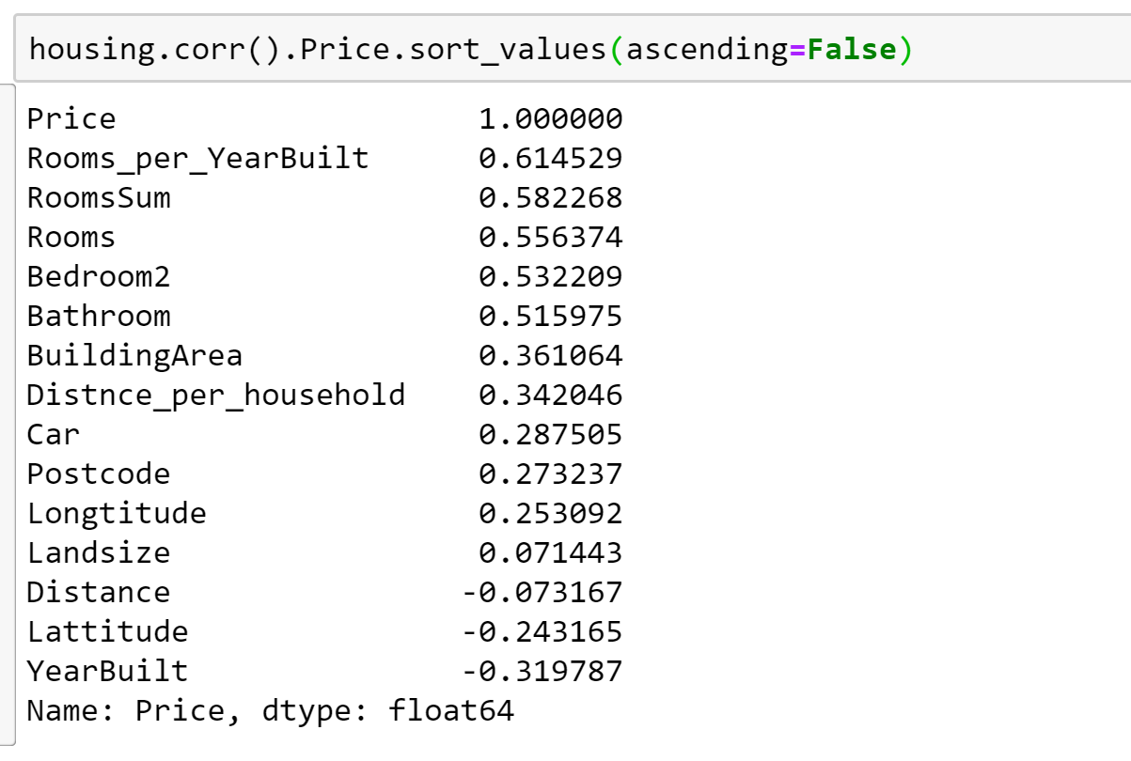
Improved Correlation
Notes:
We could improve our correlation to some extent and we can now say tht price is dependent on many features.

Slide 10
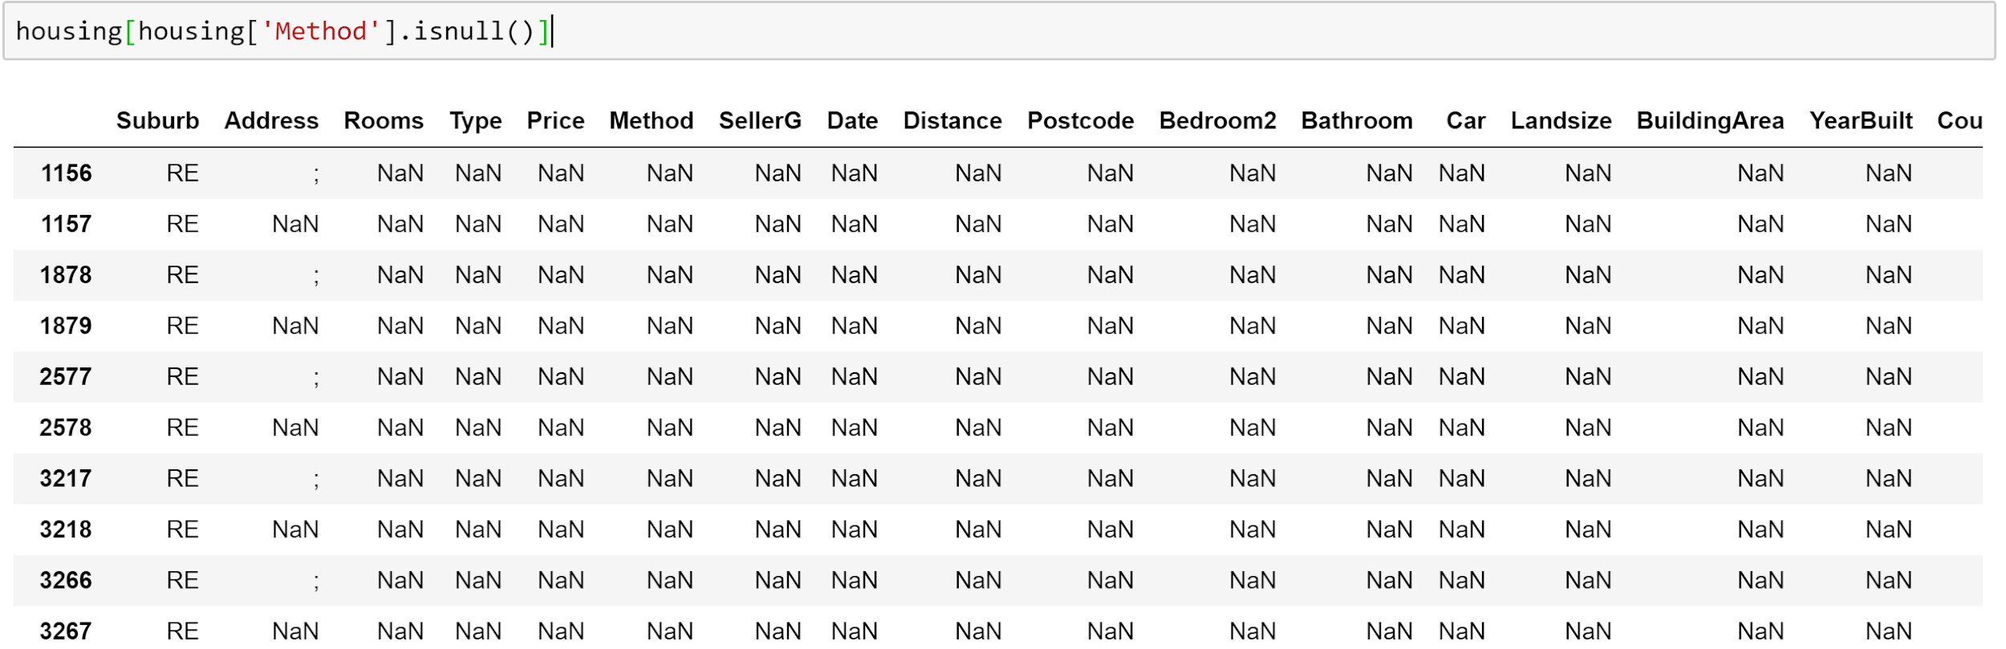
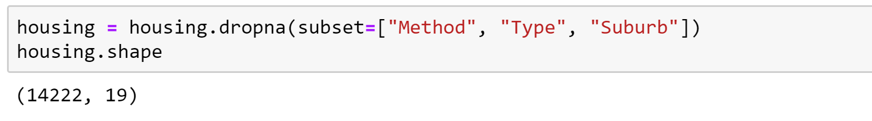
Handling null values

Slide 11
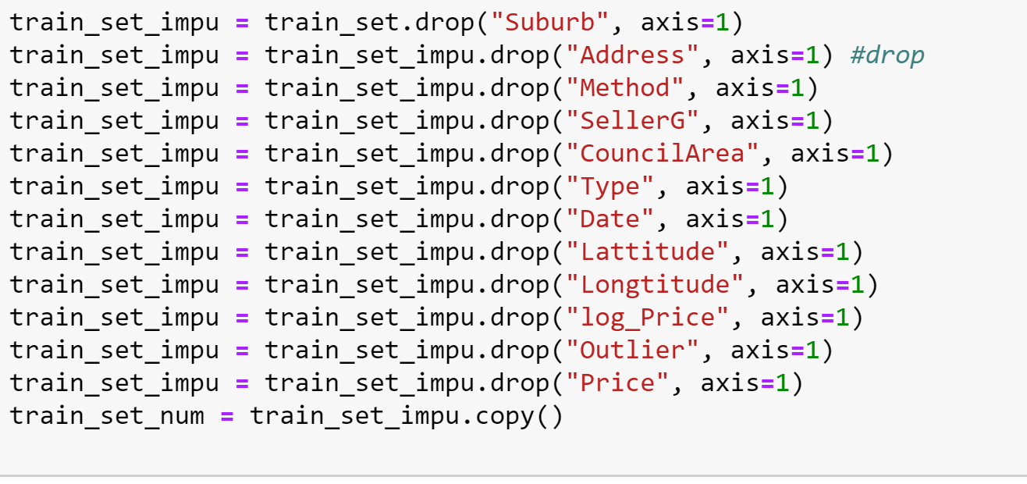
Split Train and Test Set

Slide 12
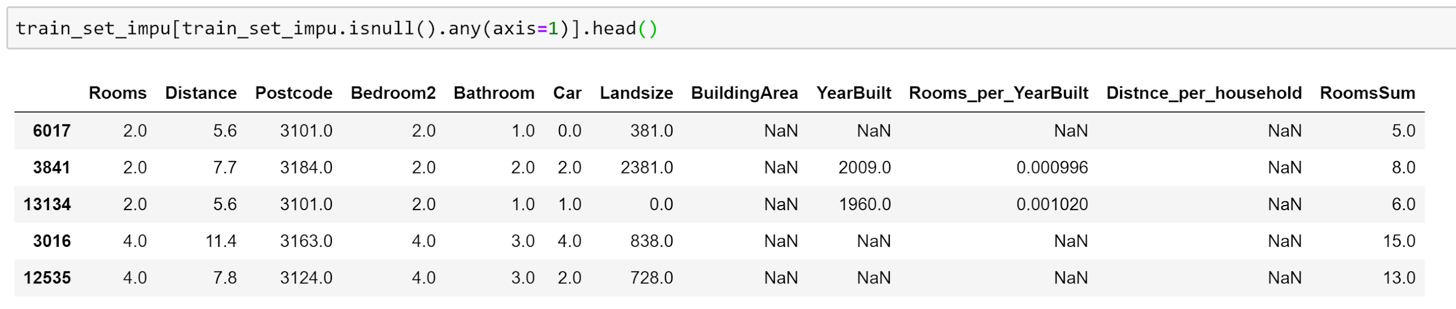
Checking for null values

Slide 13
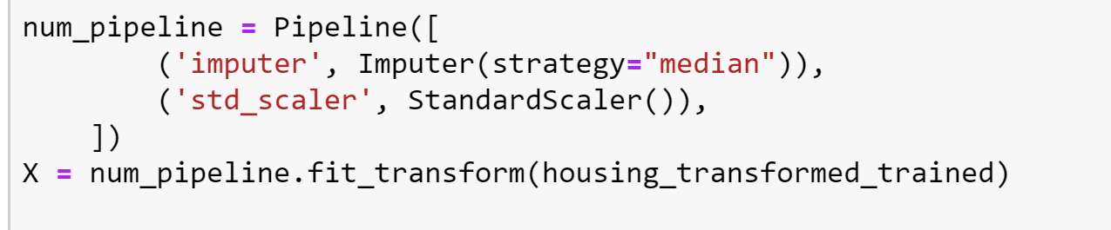
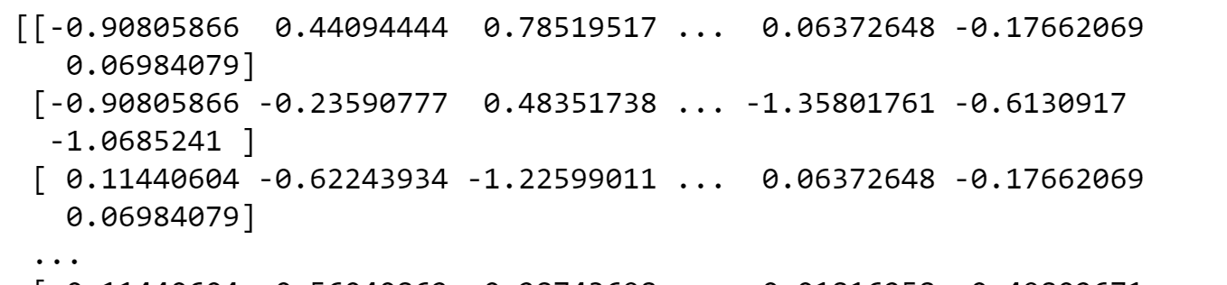
Applying Imputer

Slide 14
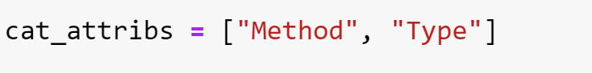
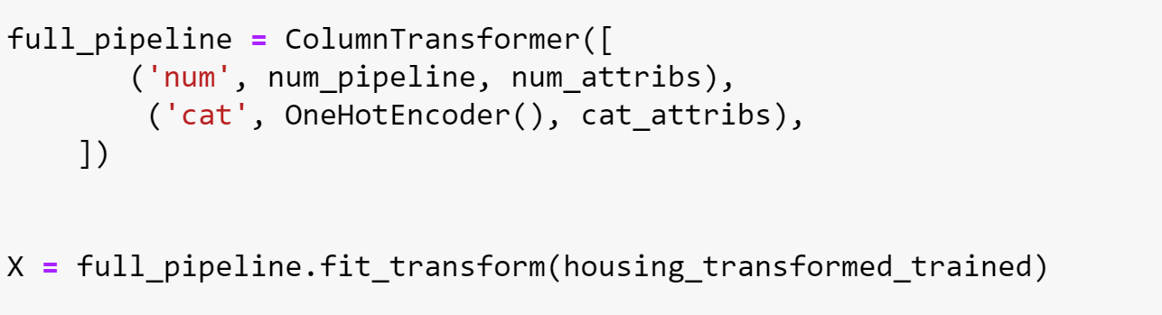
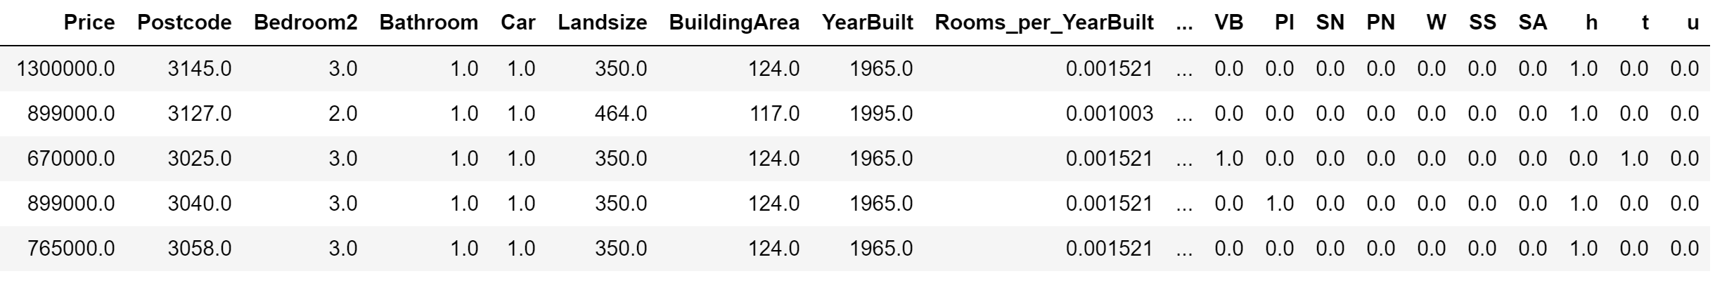
Handling categorical Data
Notes:
Type and method have been encoded.

Slide 15
Selecting a model

Slide 16
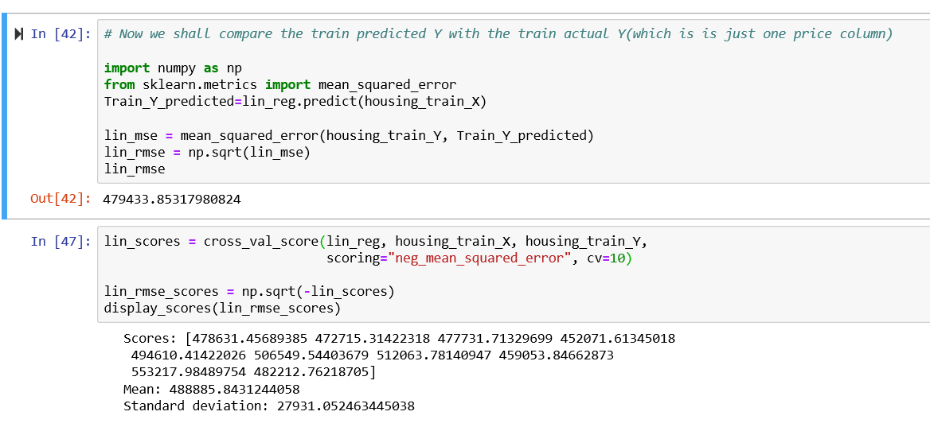
Linear Regression

Slide 17
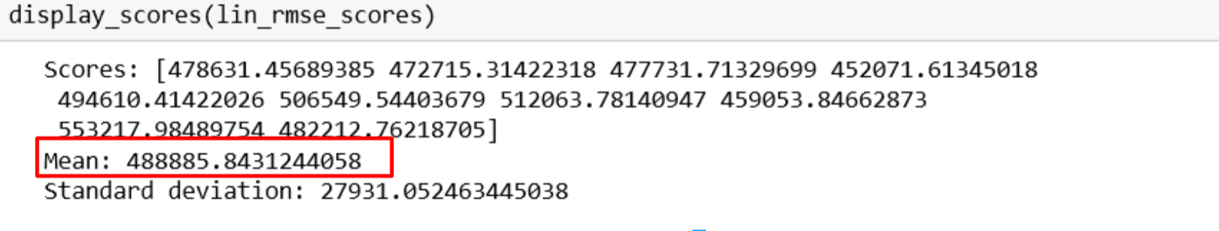
Linear Regression

Slide 18
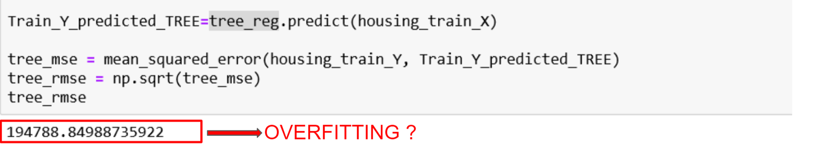
Decision Tree Regressor

Slide 19
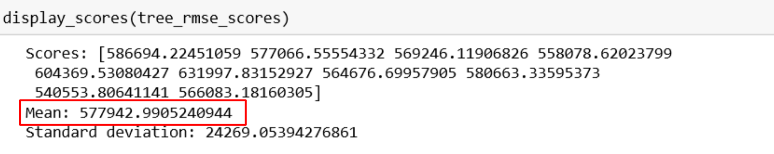
Decision Tree Regressor

Slide 20
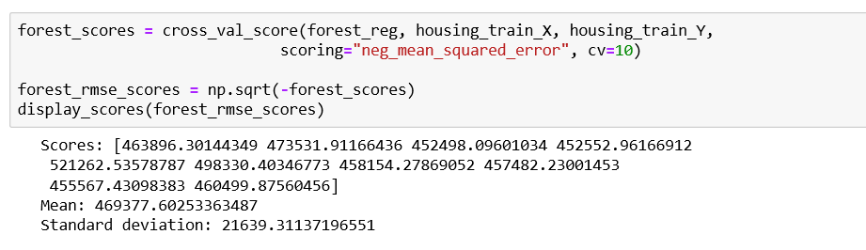
Trying Random Forest Regressor

Slide 21
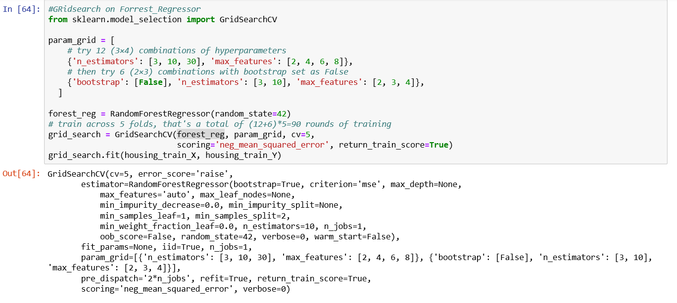
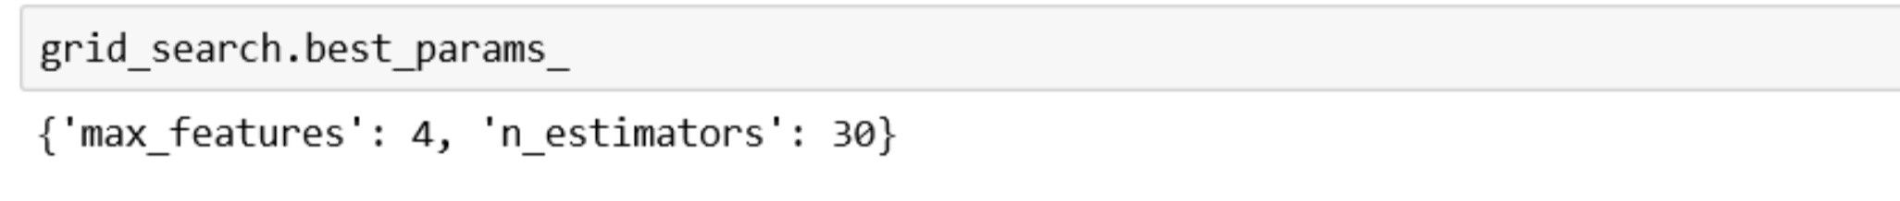
Tuning our model

Slide 22
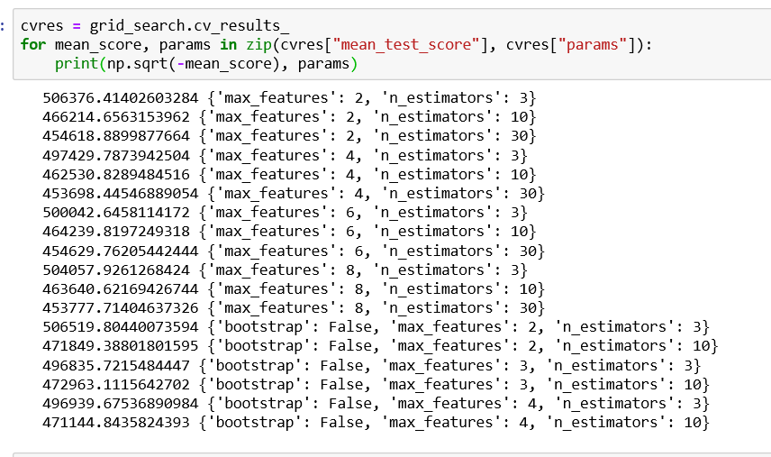
Is this the best we can do?

Slide 23
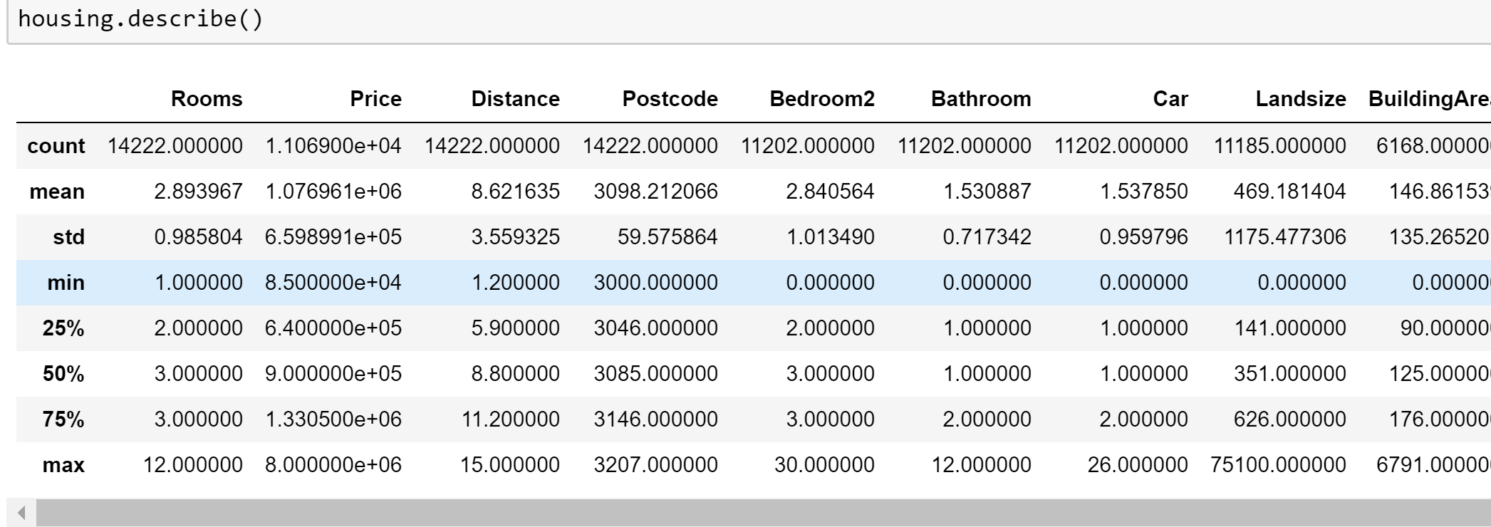
What did we miss?

Slide 24
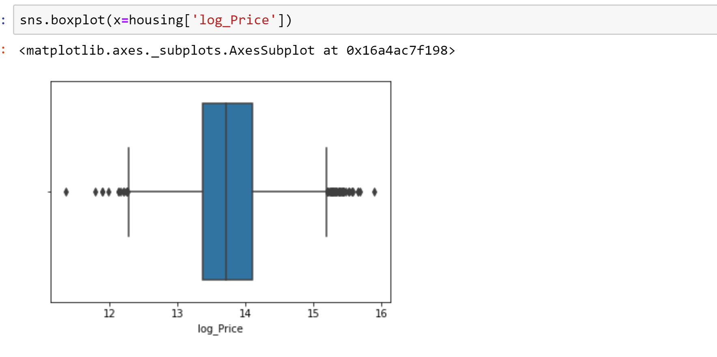
Checking for outliers

Slide 25
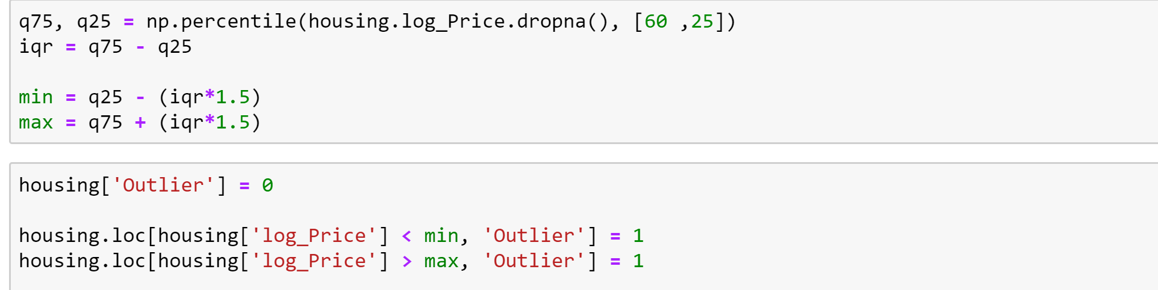
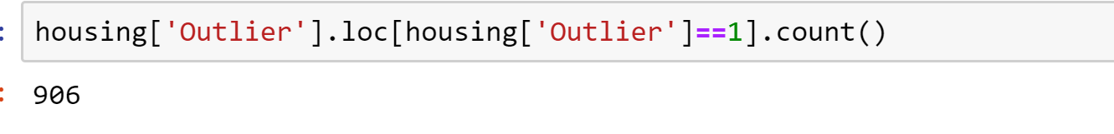
Removing outliers

Slide 26
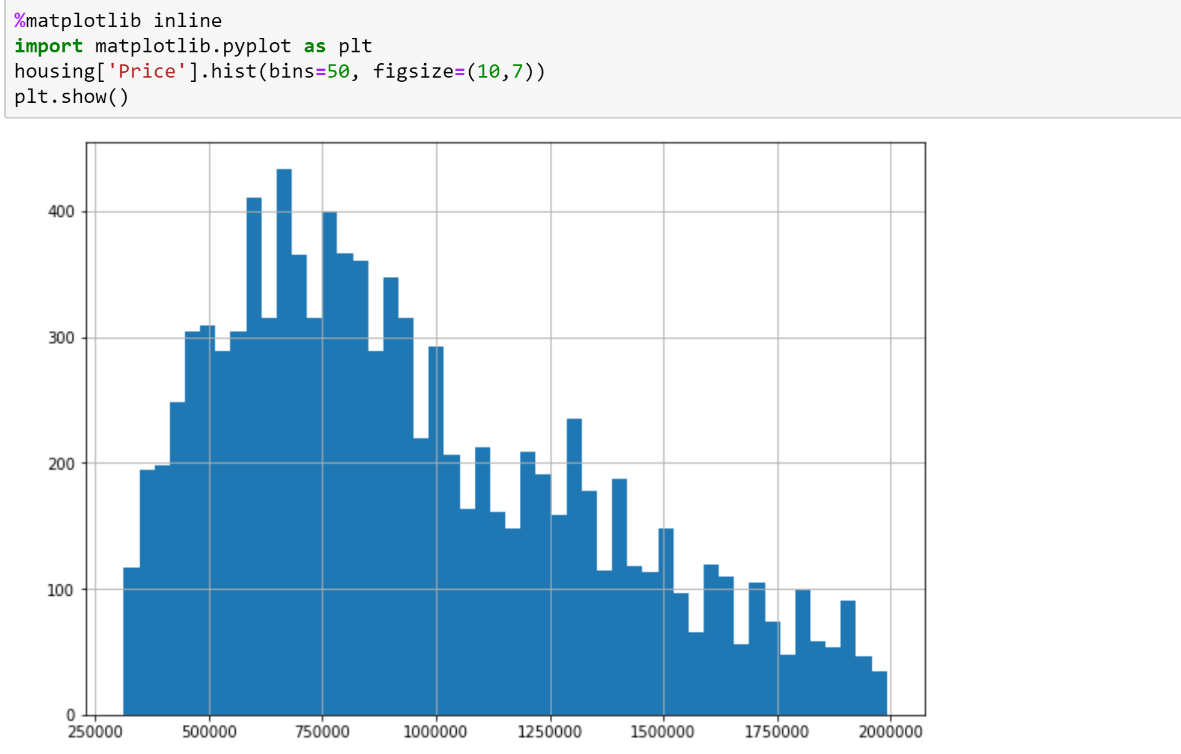
How our data looks like now?

Slide 27
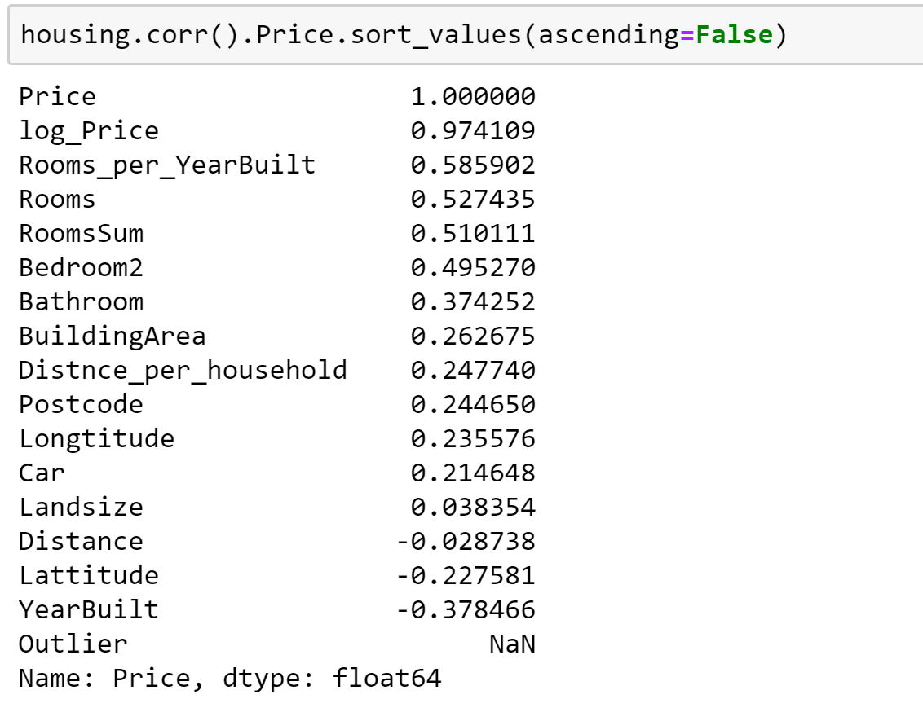
Any improvement?

Slide 28
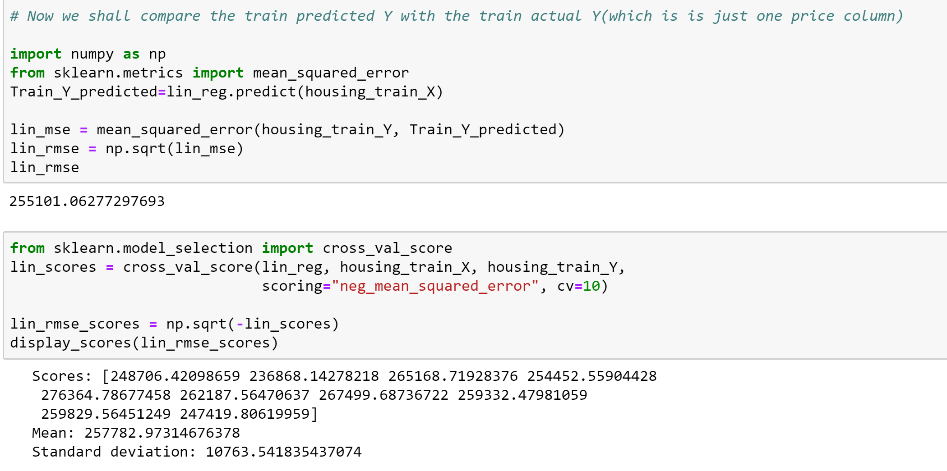

Slide 29
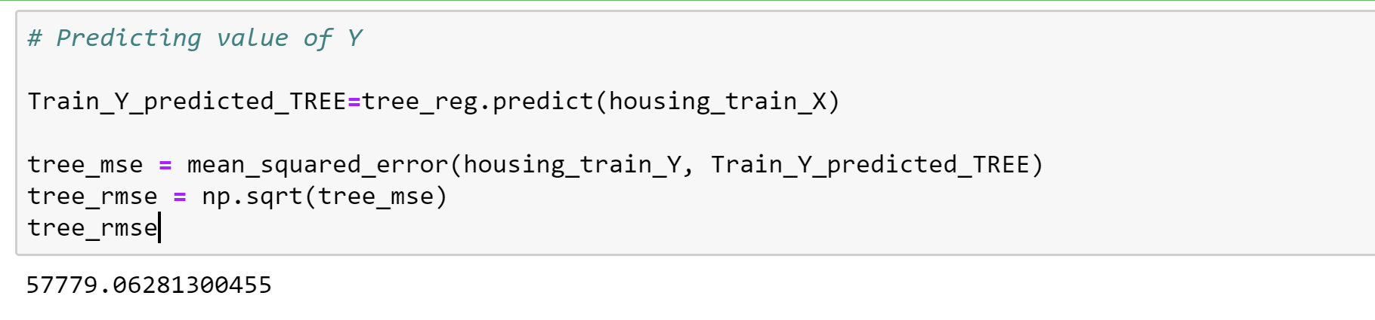
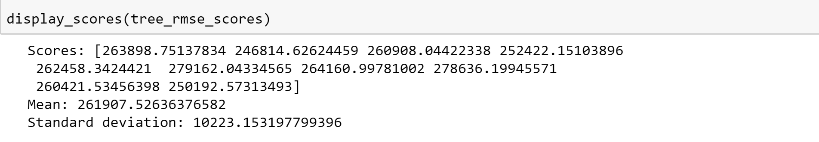
Decision Tree Regressor
OVERFITTING!

Slide 30
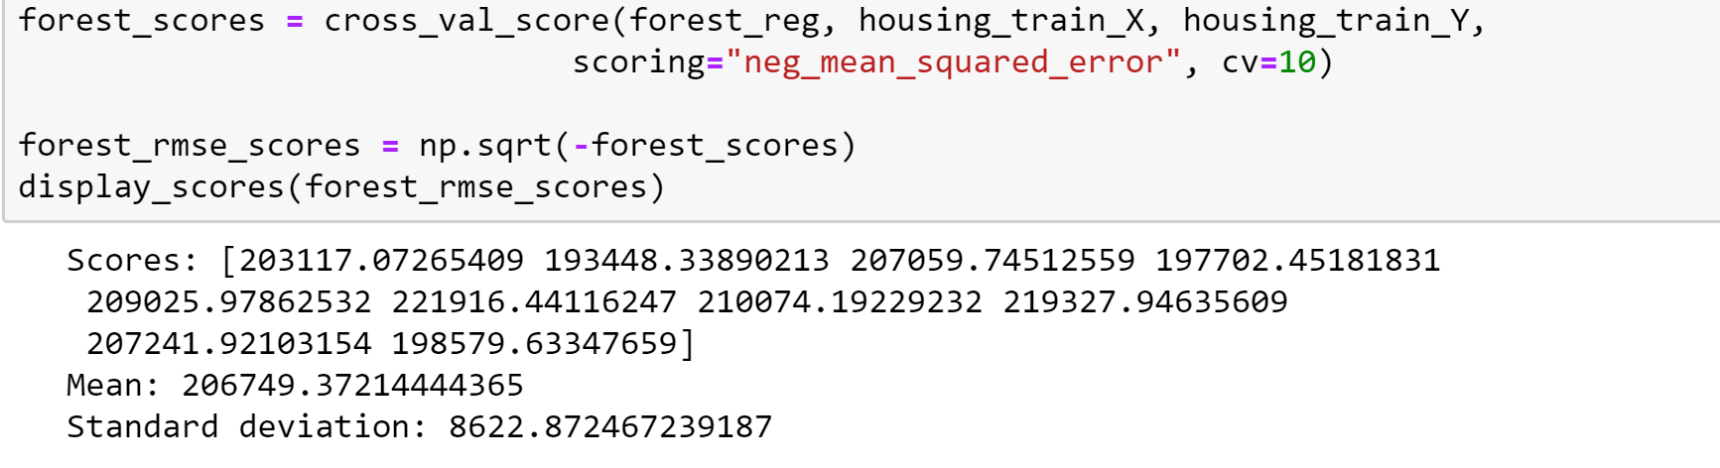
Random Forest

Slide 31
Tuning the model

Slide 32
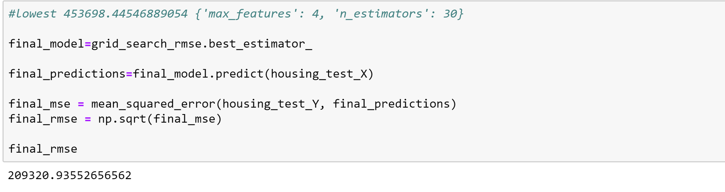
Final predictions

Slide 33
Error Progression
577K -> 488K -> 469K -> 255K-> 209K
Price Range – 313,000 to 1,992,000
Mean : 941,841 with Standard Deviation – 400,236

Slide 34
Thank you!

